Slide 1
Data Collaboration Platform
Administrator User Manual
Syrma SGS
Internal Use Only

Slide 2
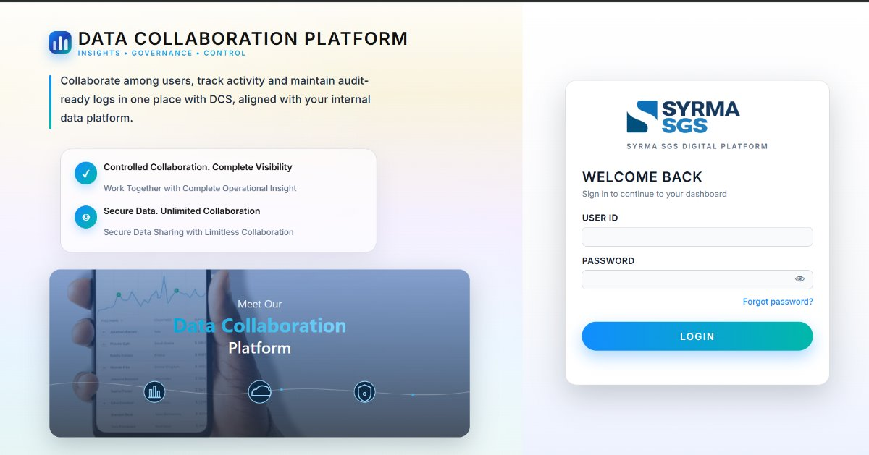

Slide 3
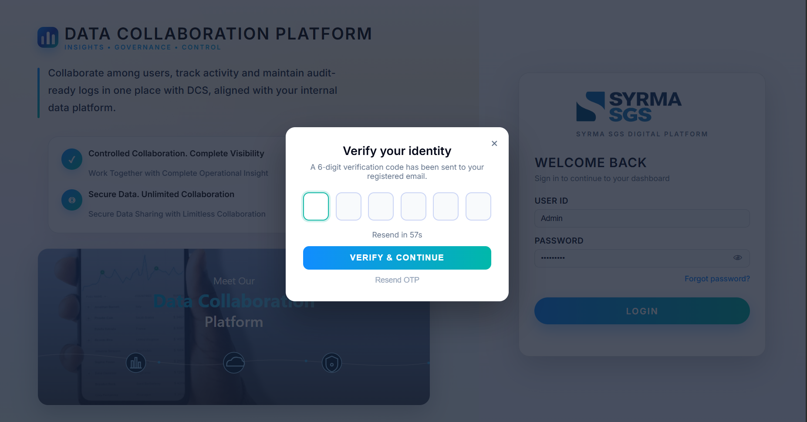

Slide 4
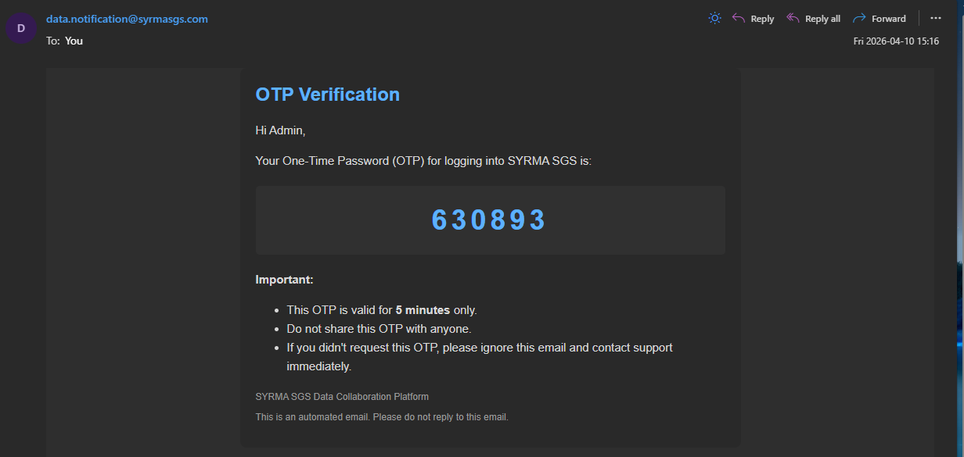
Login & Authentication
Step 1: Enter User ID and Password OR use Continue with Microsoft (SSO).
Step 2: Receive 6-digit OTP on registered email.
Step 3: Enter OTP and click Verify & Continue.
Security: OTP expires in 60 seconds.

Slide 5
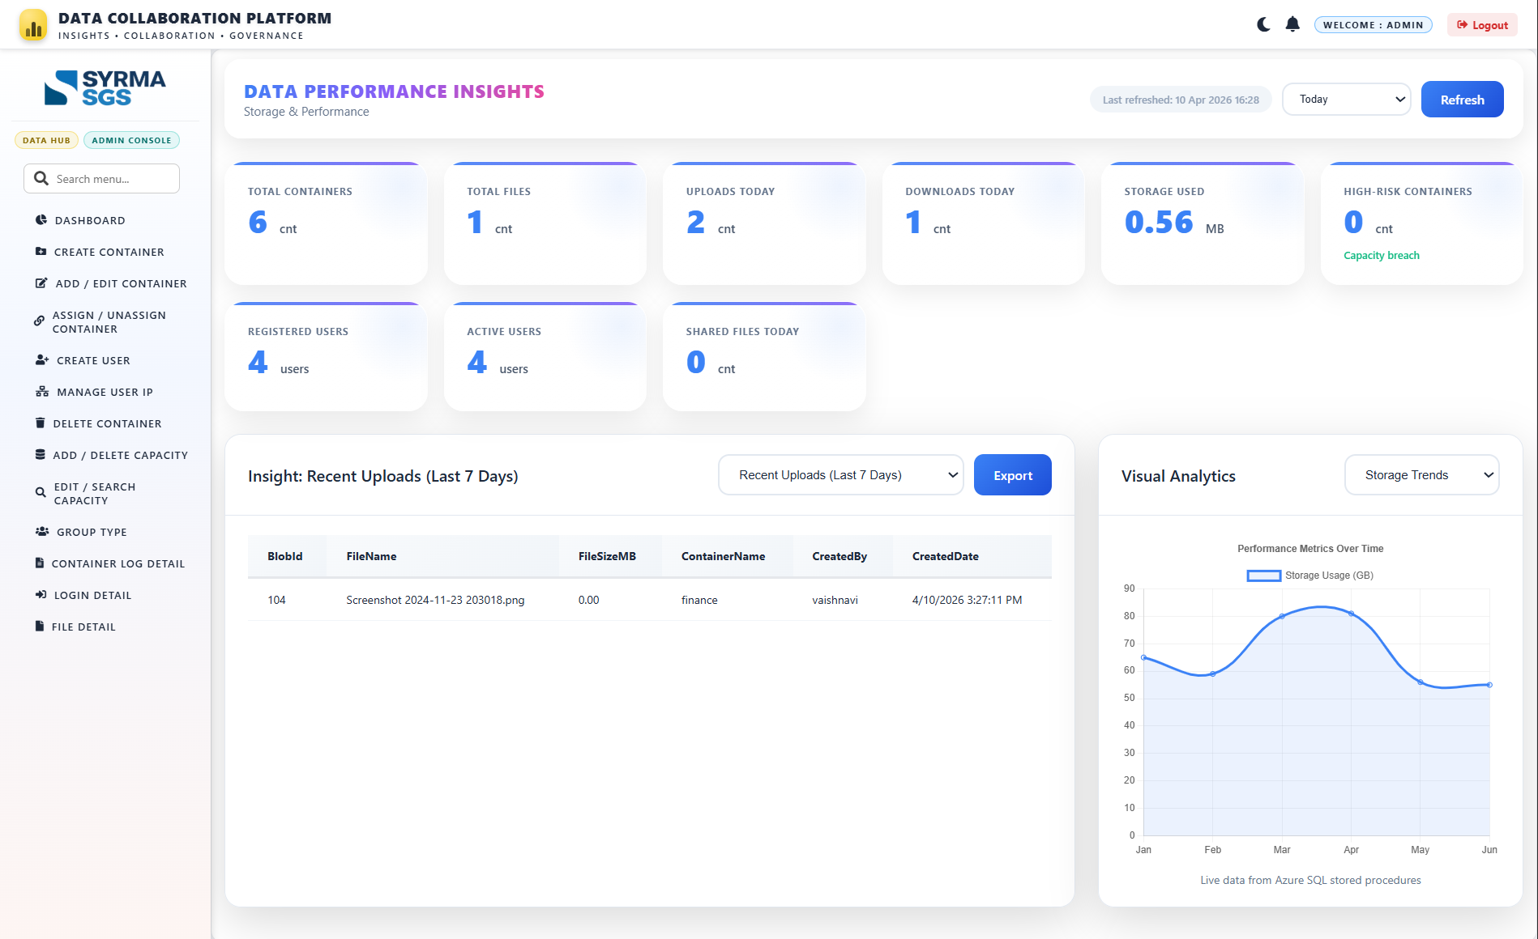

Slide 6
Dashboard Overview
Real-time KPI snapshot: Containers, Files, Storage Usage, Risk Indicators.
Track daily activity: Uploads, Downloads, and File Sharing.
Monitor user engagement: Registered vs Active Users.
View recent uploads with file details and timestamps.
Analyze storage trends through visual performance charts.
Export insights and reports for further analysis.
Use refresh controls for up-to-date system data.
Access admin actions via sidebar: Container, User, Capacity & Logs management.
Ensure system monitoring, audit tracking, and governance from a single interface.

Slide 7
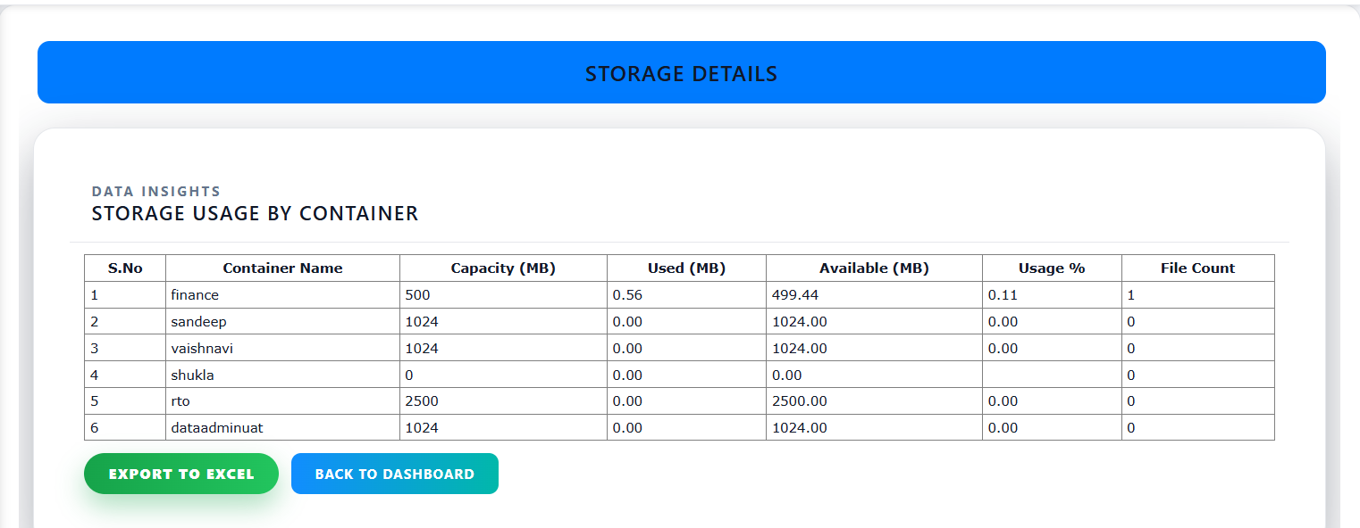
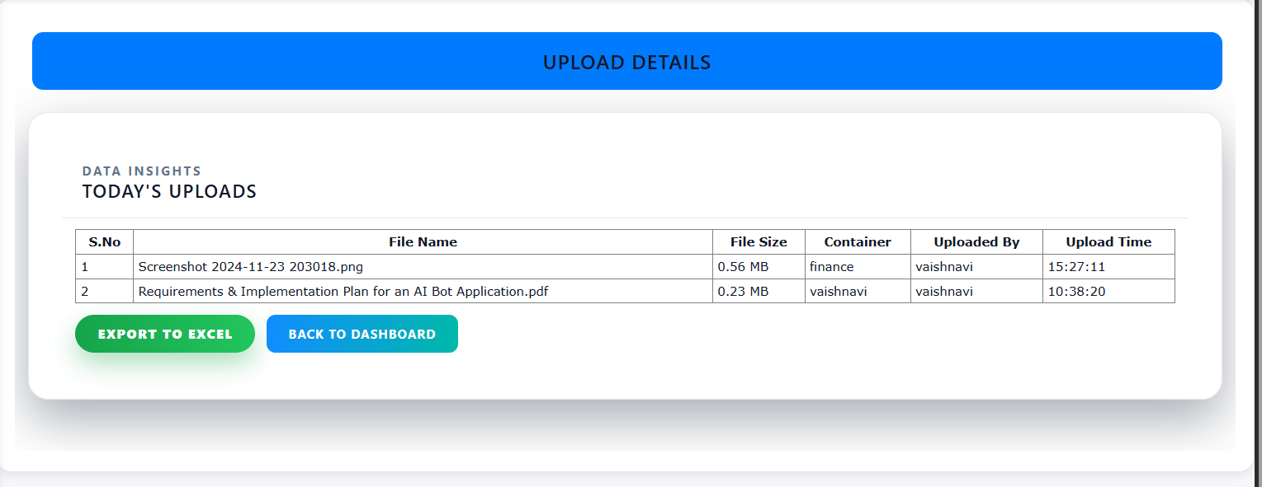
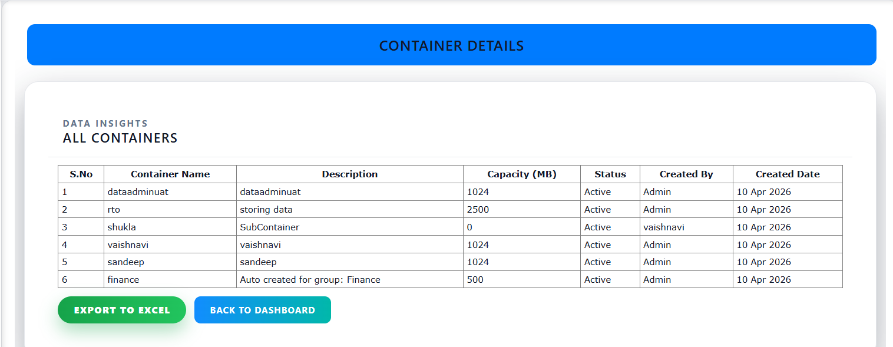
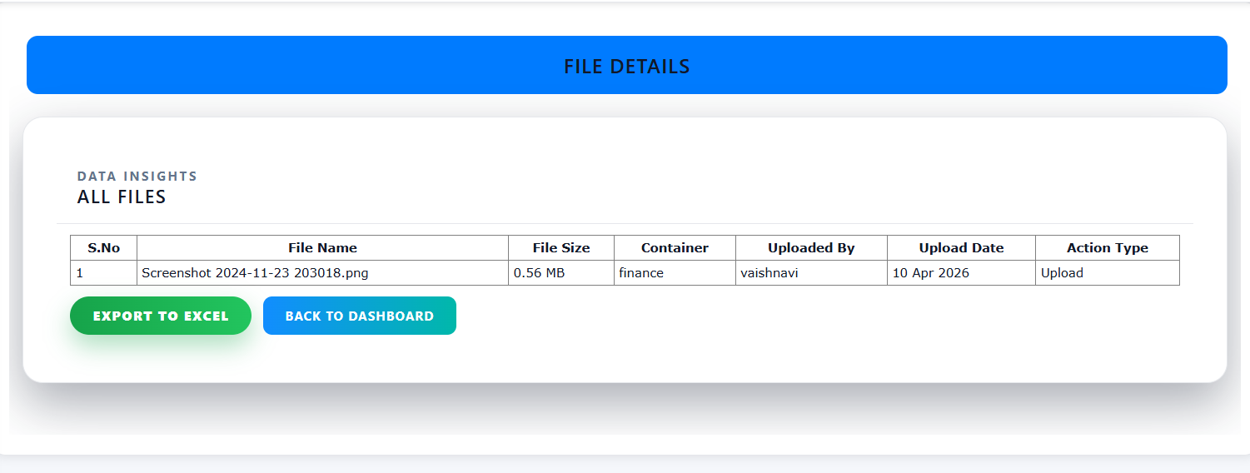
Click on any container from the dashboard to view its detailed contents and file-level information.

Slide 8
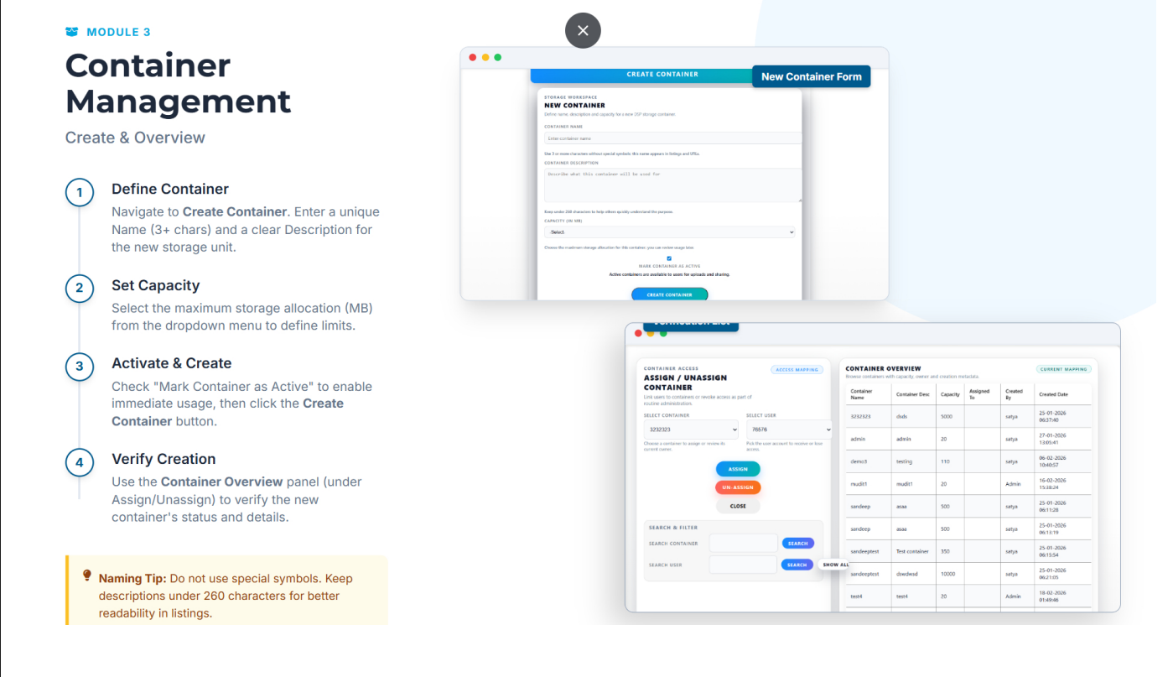

Slide 9
Container Management (Create Container)
Define Container Name and Description.
Select Storage Capacity (MB).
Mark as Active and Click Create Container.
Verify in Container Overview.
Navigation Path
Login → Admin Console → Create Container

Slide 10
Assign / Unassign Container to Users
Assign Steps:
Select the Container from dropdown.
Select the User.
Click Assign.
Confirmation message will appear.
Unassign Steps:
Select Container.
Select User.
Click Unassign.
Navigation Path
Admin Console → Assign / Unassign Container

Slide 11
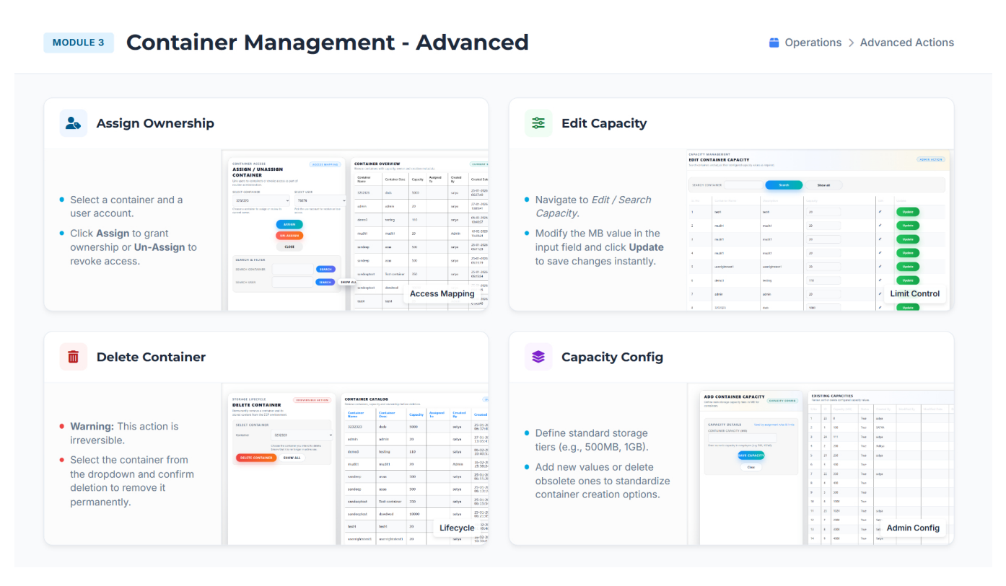

Slide 12
Delete Container
Warning
Container deletion is irreversible.
Steps:
Select the container from the dropdown.
Review container details carefully.
Click Delete Container.
Confirm deletion in the popup.
Navigation Path
Admin Console → Delete Container

Slide 13
Edit Capacity
Purpose
Allows administrators to increase or decrease container storage allocation.
Steps:
Search for the container.
Modify the Capacity (MB) value in the input field.
Click Update to apply changes instantly.
Notes:
Increasing capacity allows additional uploads.
Reducing capacity below current usage may restrict further uploads.
Changes take effect immediately.
Navigation Path
Admin Console → Edit / Search Capacity

Slide 14
Add / Delete Capacity
Purpose
Define standard storage tiers available during container creation.
Features:
Add predefined capacity options (e.g., 500MB, 1GB, etc.)
Delete obsolete capacity values
Maintain standardized storage allocation policies
Steps to Add Capacity:
Enter capacity value (in MB).
Click Save Capacity.
New value becomes available in container creation dropdown.
Navigation Path
Admin Console → Add / Delete Capacity

Slide 15
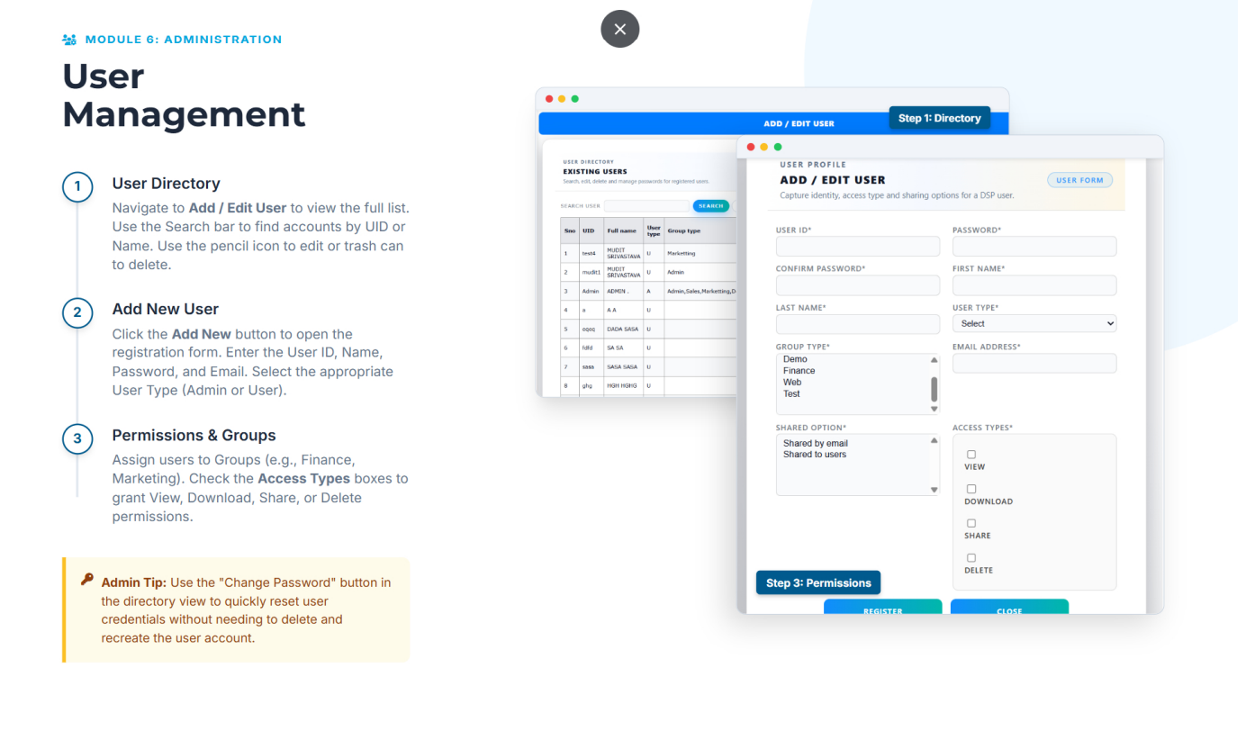

Slide 16
ADD / EDIT USER
Purpose of User Management
The User Management module enables administrators to:
View all registered users
Add new users
Edit existing user profiles
Assign groups
Define access permissions
Reset passwords
Navigation Path
Admin Console → Add / Edit User

Slide 17
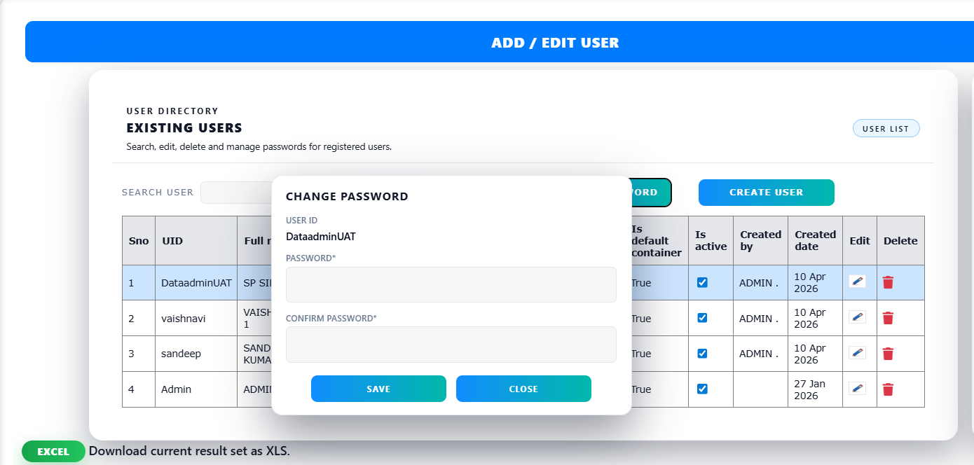
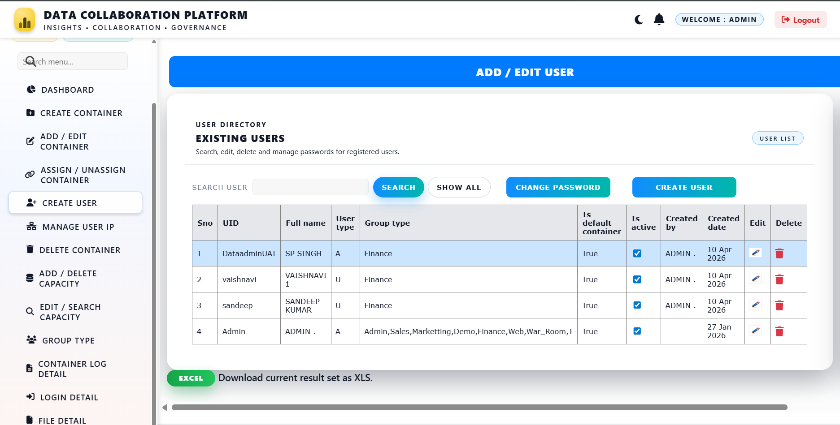
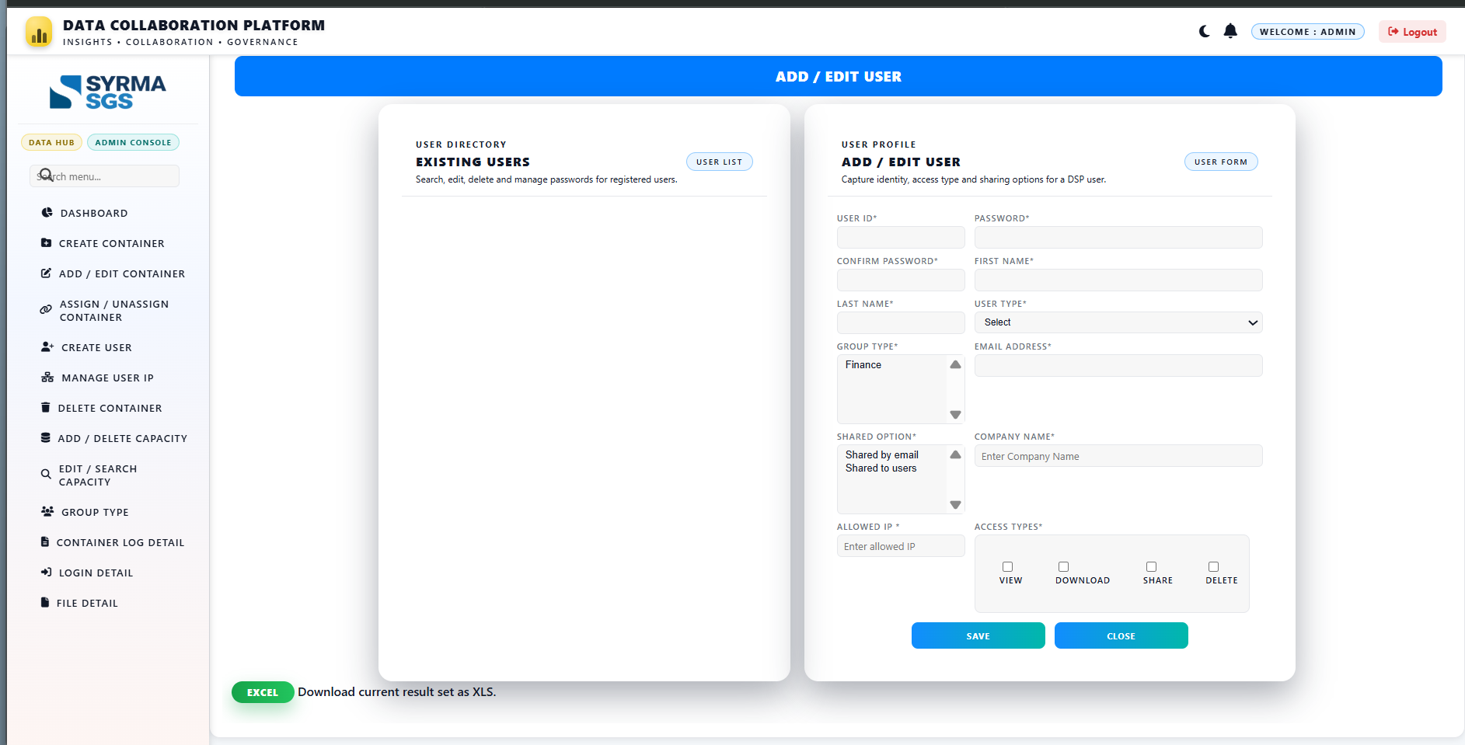
On clicking change password
Create User Page
On clicking create user

Slide 18
Add New User
Steps to Add a User:
Click Add New.
Create and manage users through the admin panel.
Assign role-based permissions (view, upload, download, delete).
Users can only perform actions allowed by the admin.
Restrict access using allowed IP addresses for secure login.
Add/remove IPs to control network-based access.
Define Group Types to organize users and containers for better access control.
Enable file/container sharing within groups or specific users.
Ensure secure collaboration through permission-based and controlled sharing access

Slide 19
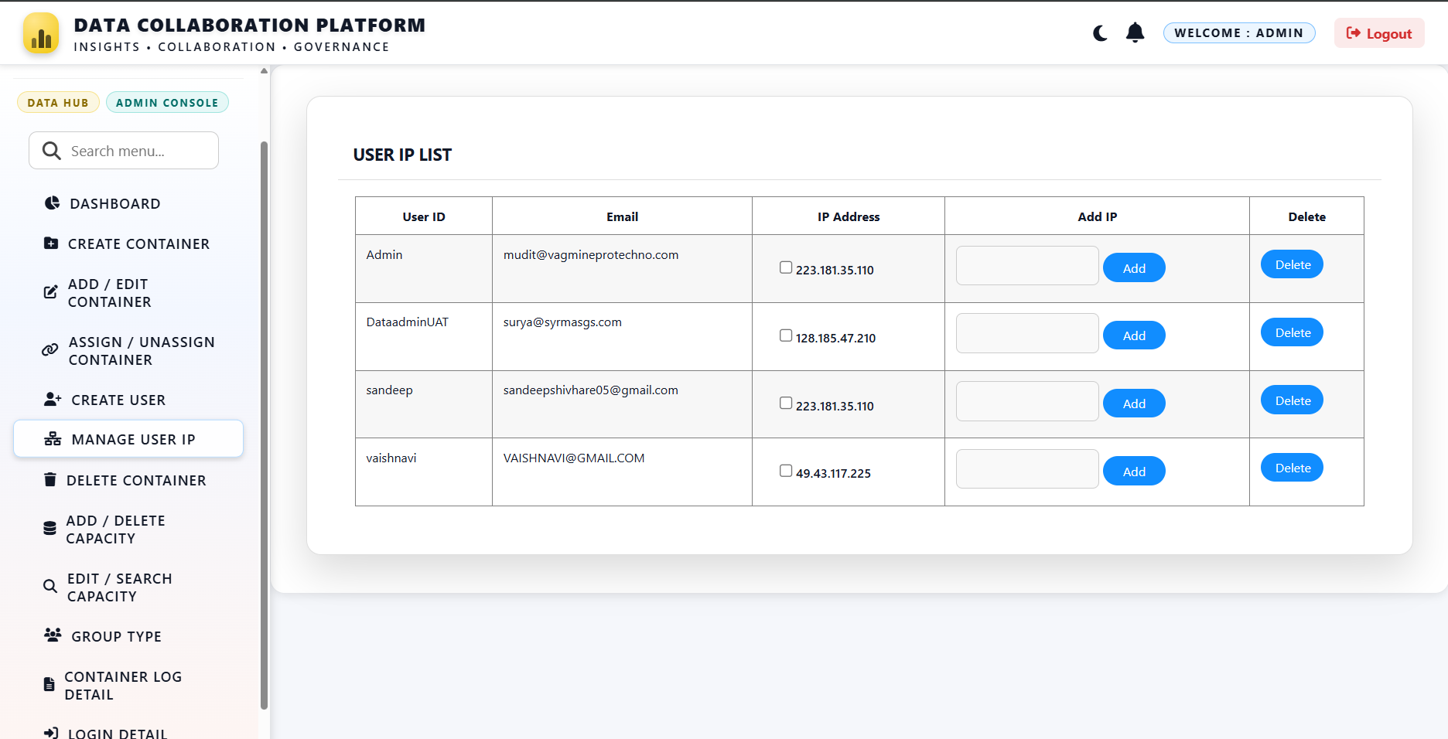
Manage User IP
View list of users along with their registered email and IP addresses.
Monitor and control IP access for each user.
Add new IP addresses to allow user access from specific networks.
Delete existing IPs to restrict or revoke access.
Enable secure access control through IP-based validation.
Support user-level network management and security governance.

Slide 20
Assign Groups & Permissions
Group Type
Users can be assigned to functional groups such as:
Finance
Marketing
Admin
Group assignment helps organize access based on department or role.

Slide 21
Access Types (Permission Control)
Administrators can grant the following permissions:
View
Download
Share
Delete
Permissions determine what actions a user can perform on files within assigned containers.
Shared Options:
Define how users can share content:
Shared by email
Shared to users
This ensures controlled collaboration policies.

Slide 22
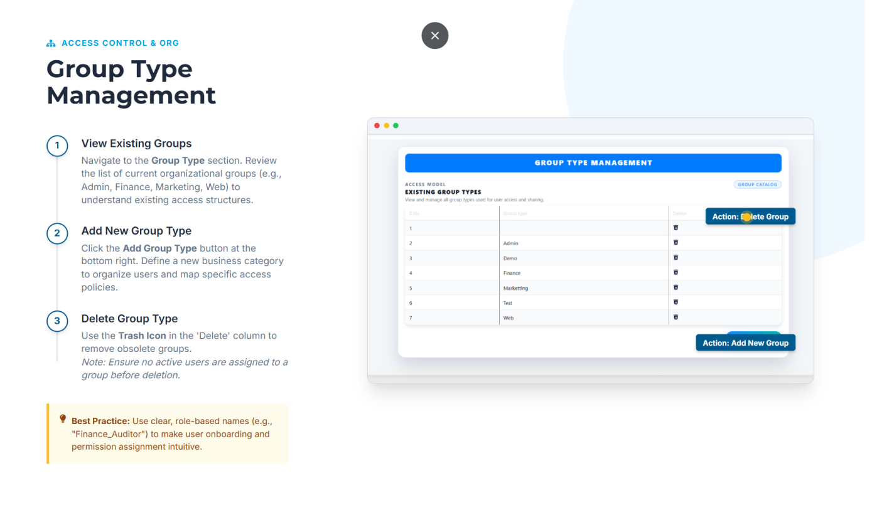

Slide 23
Group Type Management
Purpose of Group Type Management
The Group Type module allows administrators to:
Define organizational user groups
Structure access control based on department or role
Simplify permission assignment
Maintain standardized access governance
Groups help categorize users and streamline permission mapping.
Navigation Path
Admin Console → Group Type

Slide 24
Description
Displays a list of all configured group types within the system.
Information Available:
Group Name
Serial Number
Delete Option
Example Groups:
Admin
Demo
Finance
Marketing

Slide 25
Add New Group Type
Steps:
Click the Add Group Type button.
Enter the new Group Name.
Save the configuration.
The group will now appear in:
  User Management (Group dropdown)
  Access mapping configurations
Use Case:
Create new groups when:
A new department is onboarded
A new business function is introduced
Segregated access control is required

Slide 26
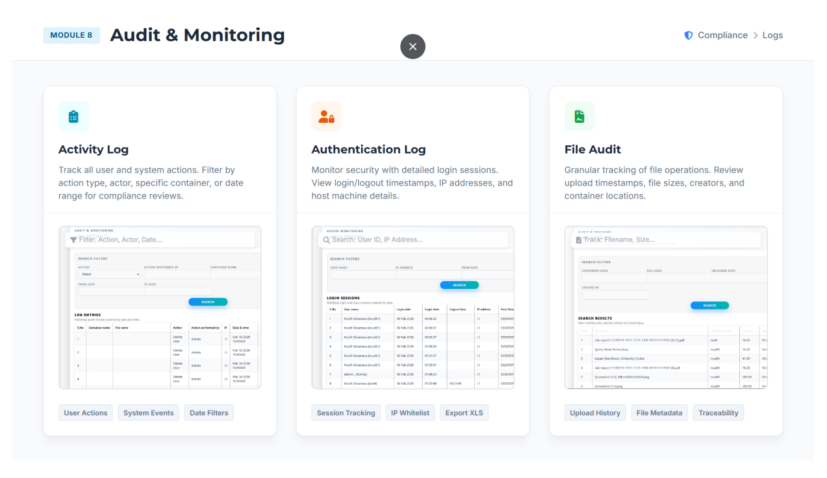

Slide 27
Audit & Monitoring
Purpose of Audit & Monitoring
The Audit & Monitoring module enables administrators to:
Track all system and user activities
Monitor login sessions and authentication details
Review detailed file-level operations
Support compliance and security audits
Export logs for regulatory reporting
This module ensures transparency, traceability, and governance control.

Slide 28
Container Activity Log Details
Purpose
Track all user and system-generated actions across the platform.
Available Filters:
Action Type
Actor (User)
Container Name
Date Range
Log Details Include:
Container Name
File Name
Action Performed (Upload, Delete, Share, etc.)
Action Performed By
Date & Time
Use Cases:
Compliance reviews
Incident investigation
Policy violation tracking
Administrative oversight
Navigation Path
Admin Console → Container Log Details

Slide 29
Login Details
Purpose
Monitor login sessions and access attempts.
Search Filters:
User ID
IP Address
Date Range
Log Information Includes:
Login Date
User Name
Login Time
Logout Time
IP Address
Host Machine Name
Administrative Benefits:
Detect suspicious login attempts
Monitor user access patterns
Validate multi-location access
Strengthen security posture
Navigation Path :Admin Console → Login Details

Slide 30
File Detail Logs (File Audit)
Purpose
Provide granular tracking of file-related activities.
Available Filters:
Container Name
File Name
Created By
Upload Date
File Metadata Includes:
Blob ID
File Name
File Size
Container Name
Created By
Created Date
Key Capabilities:
Upload History Tracking
File Metadata Review
Full Traceability
Audit Trail Export
Navigation Path :Admin Console → File Details

